Slide 1

project: portfolio analysis
Yahooo! Team Project

Slide 2

Yahooo! Team collaborators
Chris Chan
Shanshan Zhang
Sreenivas Kalva
Desmond Phan
Hemal Bavishi

Slide 3

purpose
PORTFOLIO ANALYSIS
1. ROI analysis of each Portfolio
2. Recommending the Portfolio
with the highest ROI.

Slide 4
Key discussion points
Should one of the Portfolios be user defined?
If one of the comparative analysis should be based on the option by user to just put the investment amount in term deposit
Should one of the portfolios to be picked include Crypto assets..?
Once Portfolios to be analysed is agreed, from where to fetch the data- single source or multiple source.
One of the elements of discussion was if the analysis can allow user to input the amount to be invested and user is able to pick the stocks as a part of program.
Should we concentrate just on Return on investment, or we should bring in element of risk as well in our analysis

Slide 5

Discussion outcome
Summary
Four Portfolios- with different parameters and structure to be selected for analysis
b) Group agreed to focus on ROI as a singular factor for analysis and
recommendation
Data for the analysis was fetched from yahoo finance (for stocks and crypto) and also from Quandl (for Interest rates data)
d) Analysis based solely on ROI – and recommendation of investment is
solely based on ROI

Slide 6
Discussion outcome
Detail
Four Portfolios- with different parameters and structure to be selected for analysis
Portfolio 1 is user created stock portfolio. User selects stocks from ASX and creates custom portfolio based on their respective preference.
Portfolio 2 is algorithm optimised stock portfolio of ASX stocks using python package
Portfolio 3 exhibits interest earned by user to invest the available amount in term deposit with banking institution of Australia
Portfolio 4 showcases the return on investment if whole amount is invested by user into Crypto securities with equally weightage.

Slide 7
Discussion outcome
Detail
b) Group agreed to focus on ROI as a singular factor for analysis and
recommendation
Projected ROI for future based on historical performance of
respective securities
c) Stocks and Crypto Price Data for the analysis was fetched from yahoo finance. RBA Interest rates data was available via Quandl.
d) Analysis based solely on ROI – and recommendation of investment is
solely based on ROI
Risk analysis not factored when recommending suitable Portfolio for investment.

Slide 8
Data- fetch, clean, explore
Key challenge
Key steps
10 year historical data for Crypto asset was not available. So 5-yr data was used.
Which interest rate to use for analysing option where user invests amount in term deposit. We used RBA cash rate and did not add any bank premiums.
Implementing an appropriate forecasting model to forecast future interest rates (such as ARIMA etc).
Crypto historical data not available in Alpaca. Decision made to fetch data from Yahoo Finance- and even if Data available is for 5 years, it was understood that its enough for analysis purposes
Clean up and formatting the Data
Checking the null values and formatting it
Checking the stats for validity and correctness

Slide 9
Data- fetch, clean, explore
* PRESENT JUPYTER LAB SOURCE CODE *

Slide 10
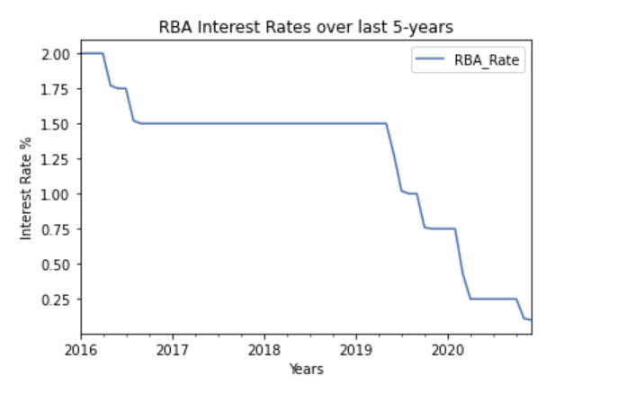
Data- KEY FINDINGS
LOW INTEREST RATES
RBA has loosened its monetary policy with lower interest rates for improving investment and create jobs

Slide 11
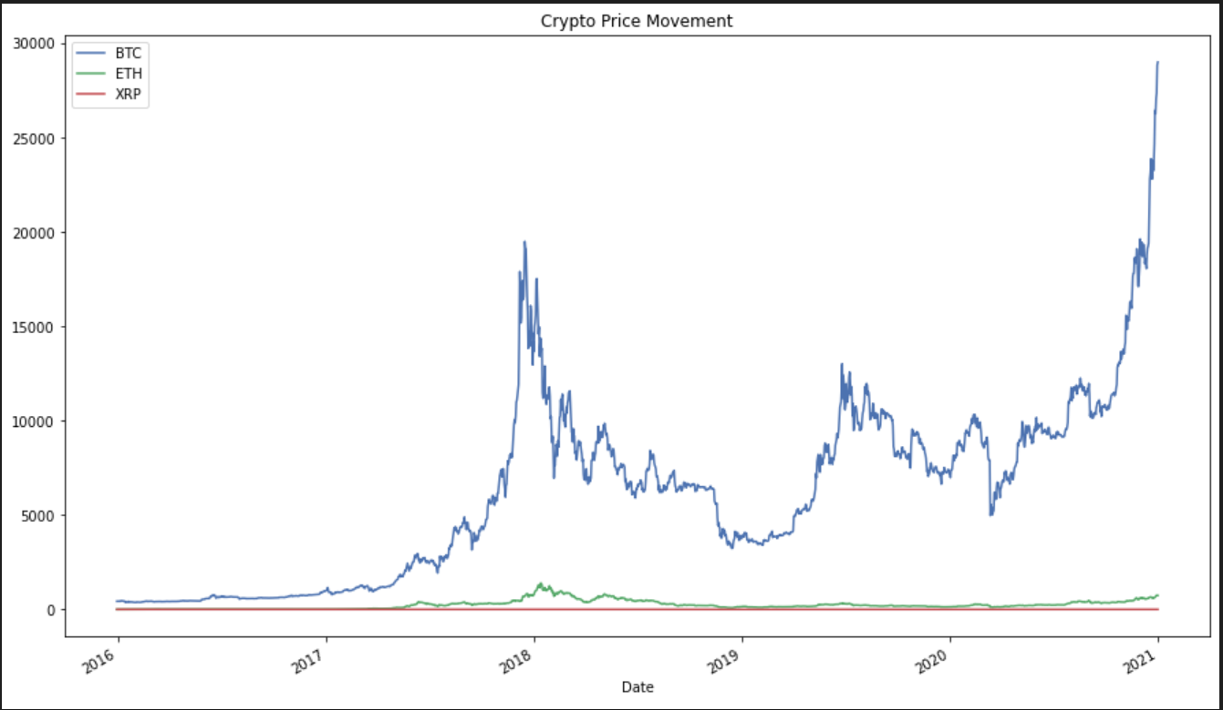
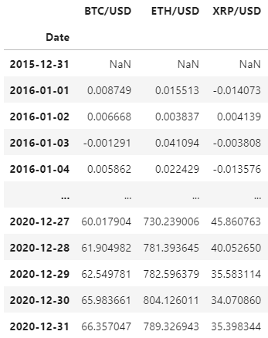
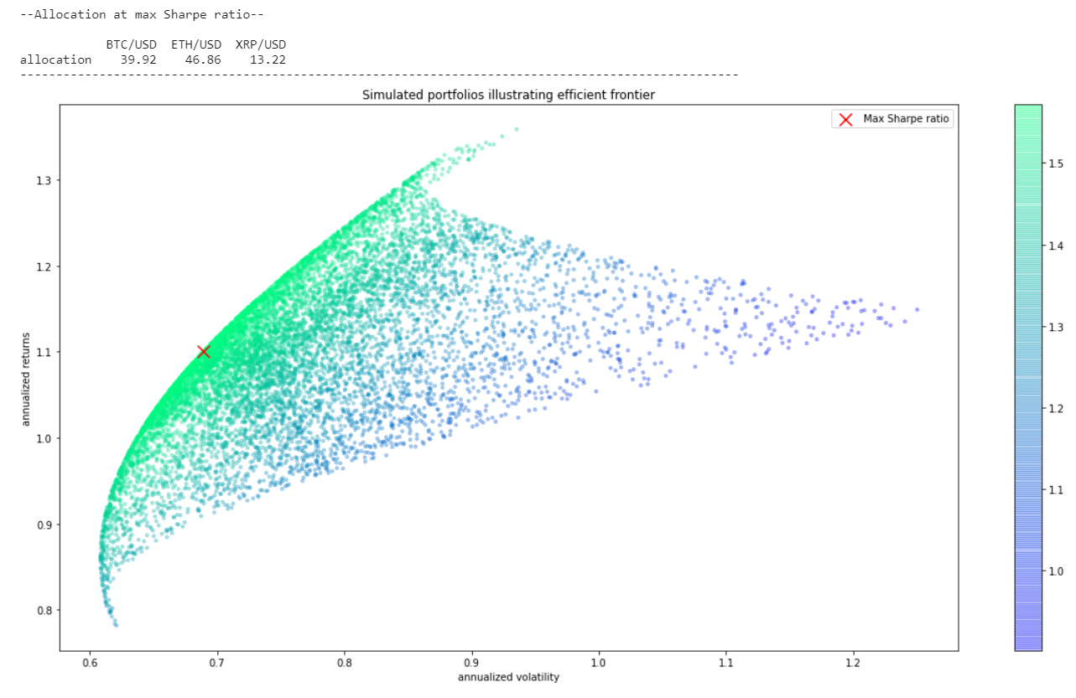
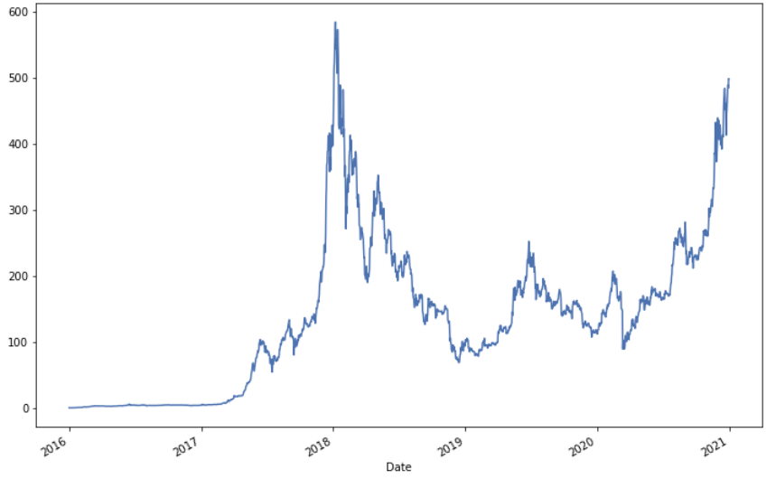
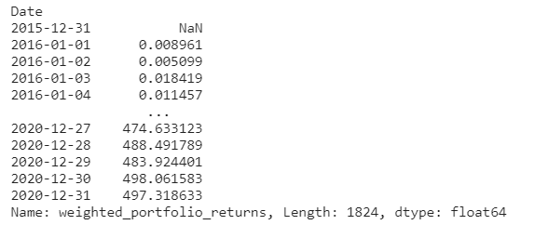
Portfolio 4 - Optimized Crypto portfolio
A highly volatile but also ‘extremely lucrative’ investment
Assumption:
User go ‘all-in, berserk mode’ into crypto
Timeframe: 1/1/2016 – 1/1/2021
Findings:
Ethereum gave better returns
Annualized return = 11000%; Cumulative return 5-y = 49,700%
An investment of $1,000 in 1/1/2016 should give a return of $497,318 in 1/1/2021

Slide 12
Data- KEY FINDINGS
Ranking of 4 Portfolios based on ROI provided interesting perspective:
ROI comparison of 4 Portfolios
Using EfficientFrontier provided better returns when compared to user picked stock portfolio. This shows that using machine learning algorithms will outperform the returns.
Unavailability of historical data for Crypto’s to accurately forecast the growth over next 10-years
Crypto’s will need to part of the investment portfolio for all- considering the significant ROI.
Keeping the money in the bank fixed term portfolio will always provide least ROI over medium to long terms.

Slide 13
Key learnings
10-year historical data for Crypto is not available easily
Risk is not calculated and taken in analysis- and a learning that risk is the key element for Portfolio analysis
Investment in term deposit provides the least ROI over medium to long terms
Crypto Investment delivered maximum ROI
In most instances, User portfolios returns will provide a lower ROI than Optimised portfolio

Slide 14
Enhancement to project- time permitting..!
Inclusion of additional Portfolio - a Real Estate asset class- to understand the ROI differences between different asset class.
Creating a “mixed/hybrid portfolio” using Stocks+Crypto+RealEstate- and understanding the impact of ROI between 2 diversified Portfolios
Forecast interest rates using the models such as ARIMA
Projecting the share fluctuations and future earnings.
Investigation of the potential of commercialisation of this tool, so general public can use it as pay-per-use model.
Indepth analysis of risk vs return- by adding “risks of each asset class/portfolio”, individual risk and return goals.
Developing a mobile app for users to subscribe..

Slide 15
THANK YOU
Q & A

